Slide 1
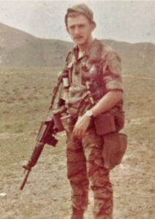
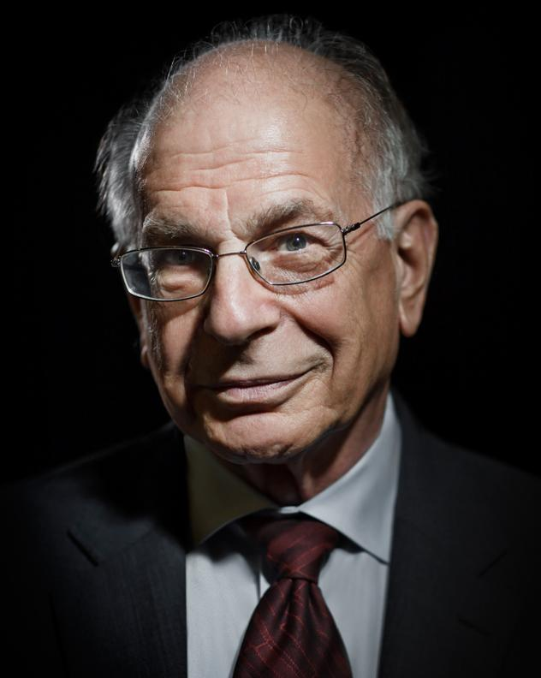
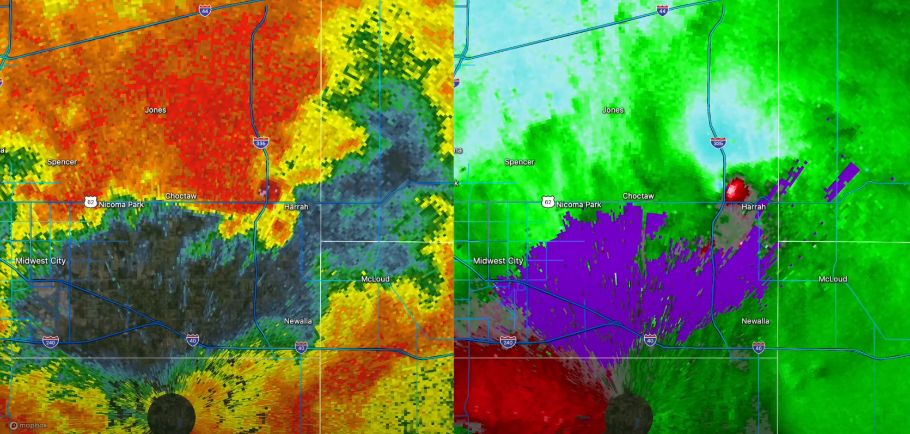
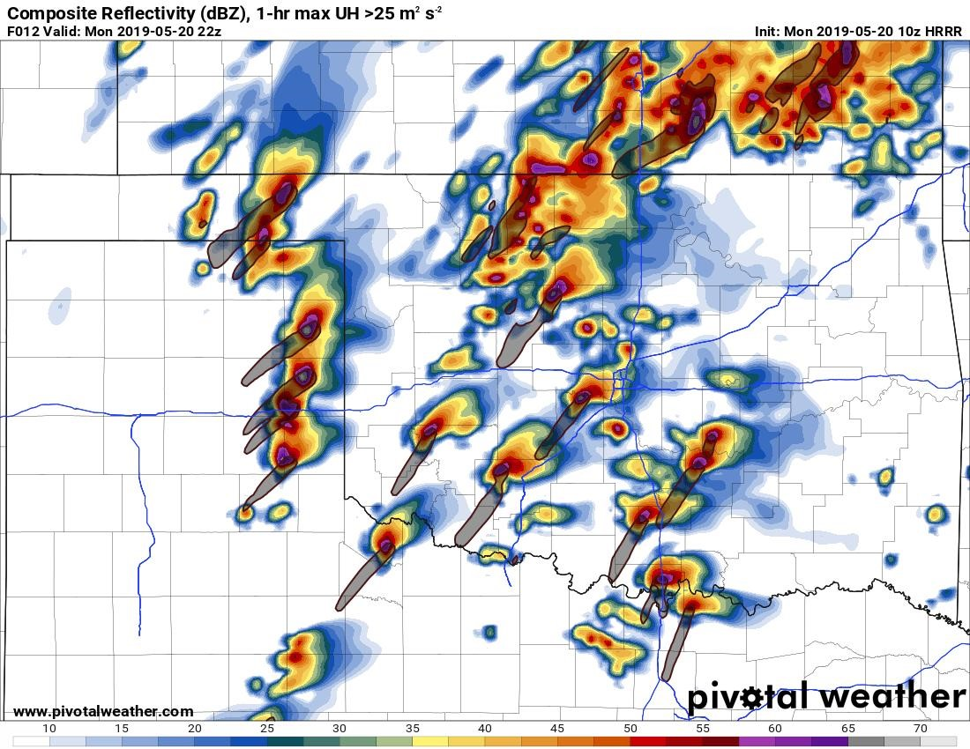
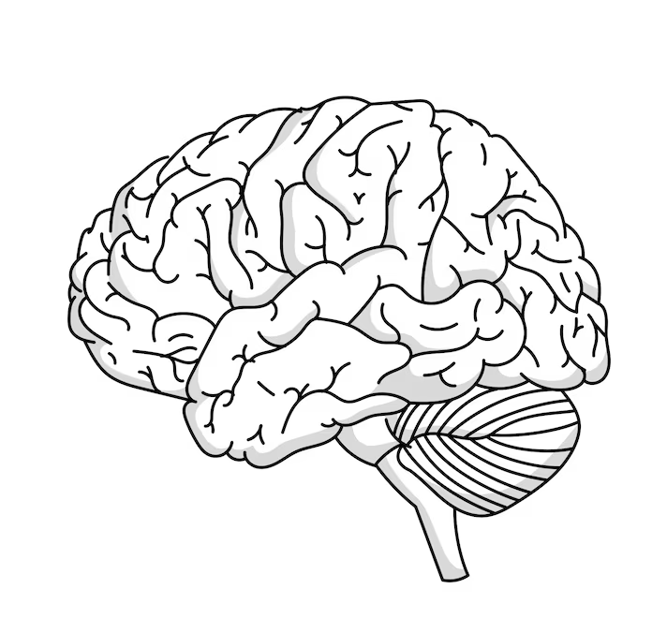
Psychology of Forecasting
Mental Biases and their Impacts on Human Weather Prediction

Slide 2
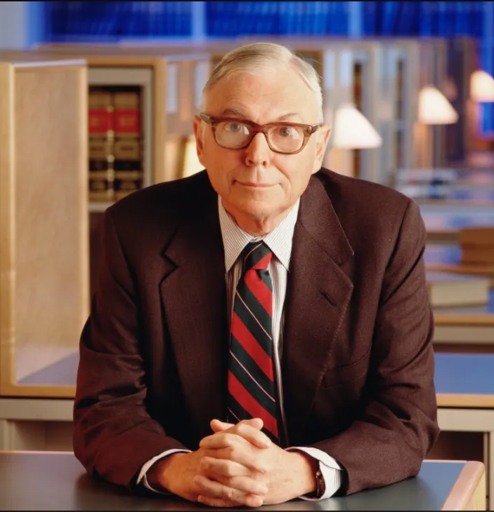
Knowing the science is only half the challenge!
Understanding the physics behind the atmosphere is not useful if you can’t apply it.
Successful application of the concepts is what matters, but depends on correct decision making!
So how do we make better decisions?
  Experience (takes time)
  Knowing how to avoid common pitfalls and biases (need awareness)
Guiding principles of Charlie Munger, very successful investor and WW2 meteorologist

Slide 3
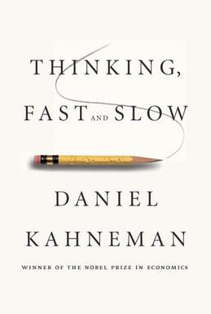
Common Heuristics
Simple mental “shortcuts” that allow us to solve difficult problems via simplification and/or substitution based on past experience.
Heuristics can be thought of as subconscious biases and can take
on many forms.
Examples include:
Anchoring bias
Confirmation bias
Recency bias
Availability bias
Many more!
Highly
Recommend!

Slide 4
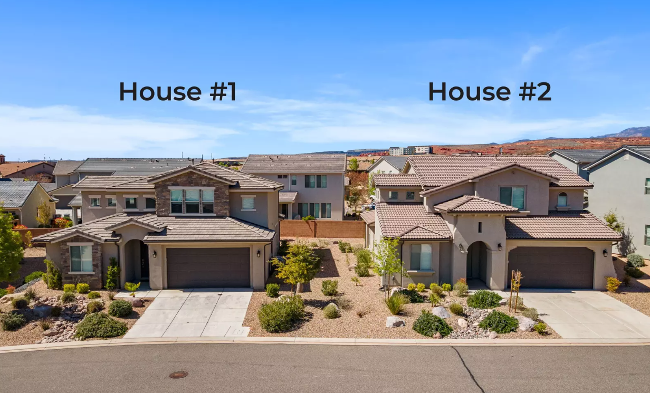
Pop Quiz!
Here are two houses that are neighbors.
House #1 sold for $350,000.
What is the price of house #2?

Slide 5
Anchoring Bias
Consciously or subconsciously making an assessment based on some suggested value or outcome.
What does the distribution of the price guesses look like? Should it have any correlation with the price of House #1?

Slide 6
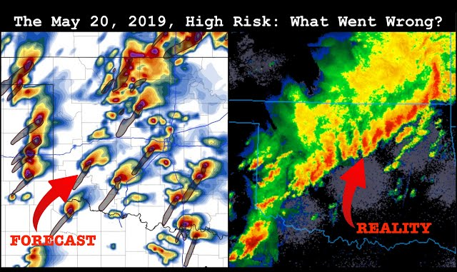
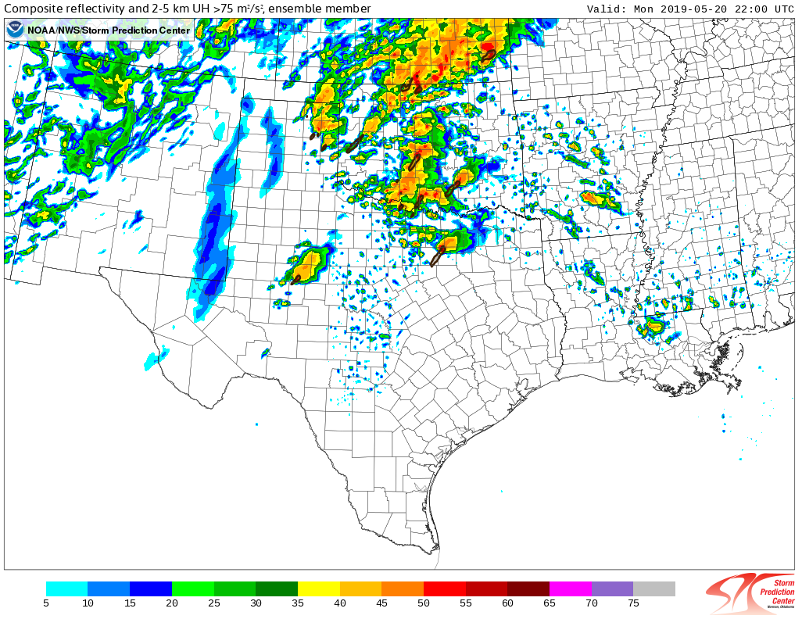
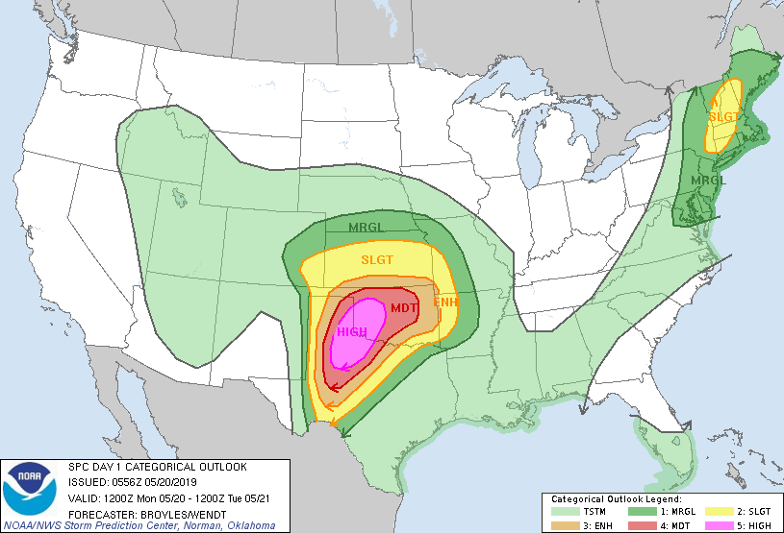
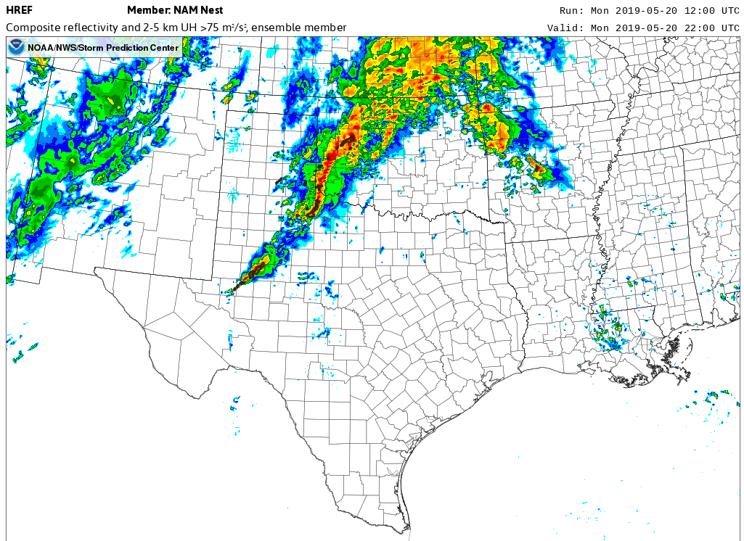
Anchoring Bias
Consciously or subconsciously making an assessment based on some suggested value or outcome.
Weather Example: May 20, 2019
Some CAM solutions were very bullish, others weren’t. How much did the bullish CAMs influence the forecast?
This is why CAM/ML guidance should be the last step in your forecast process!
Courtesy of
Convective Chronicles

Slide 7
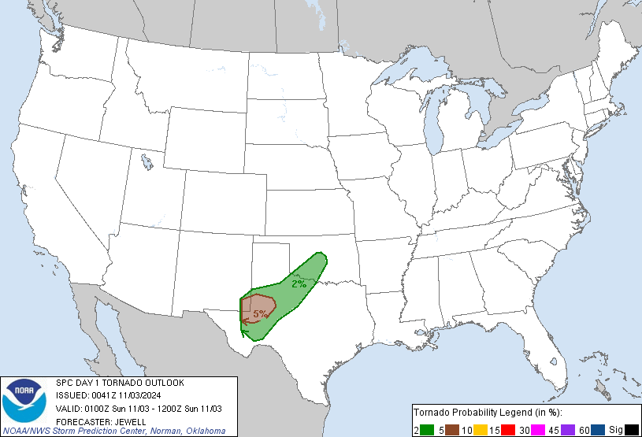
Anchoring Bias
Consciously or subconsciously making an assessment based on some suggested value or outcome.
Weather Example: November 2/3, 2024
2% Tornado risk going into the overnight hours
for central Oklahoma…
Expectation for tornadoes should be low, right?
Be careful not to let prior forecasts bias your perception of the current environment!

Slide 8
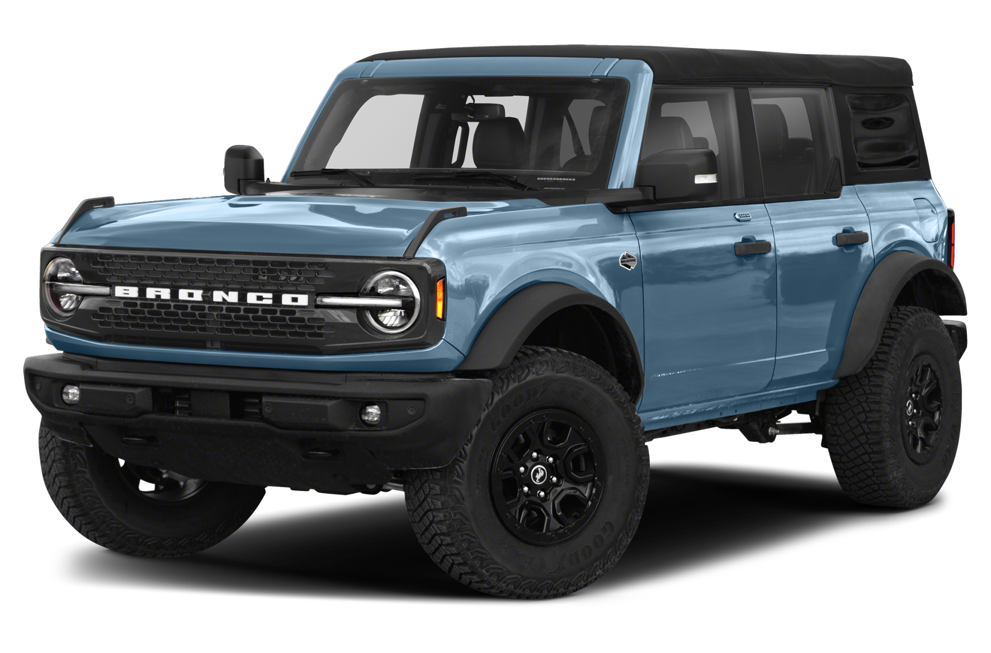
Confirmation Bias
Acknowledging signals that conform to your prior beliefs while ignoring or discounting signals that refute your prior beliefs.
Example: You really like the new Ford Bronco…

Slide 9
Confirmation Bias
Acknowledging signals that conform to your prior beliefs while ignoring or discounting signals that refute your prior beliefs.
Example: You really like the new Ford Bronco…
Then you start to see them everywhere!
Why?
You’re subconsciously looking for them!

Slide 10
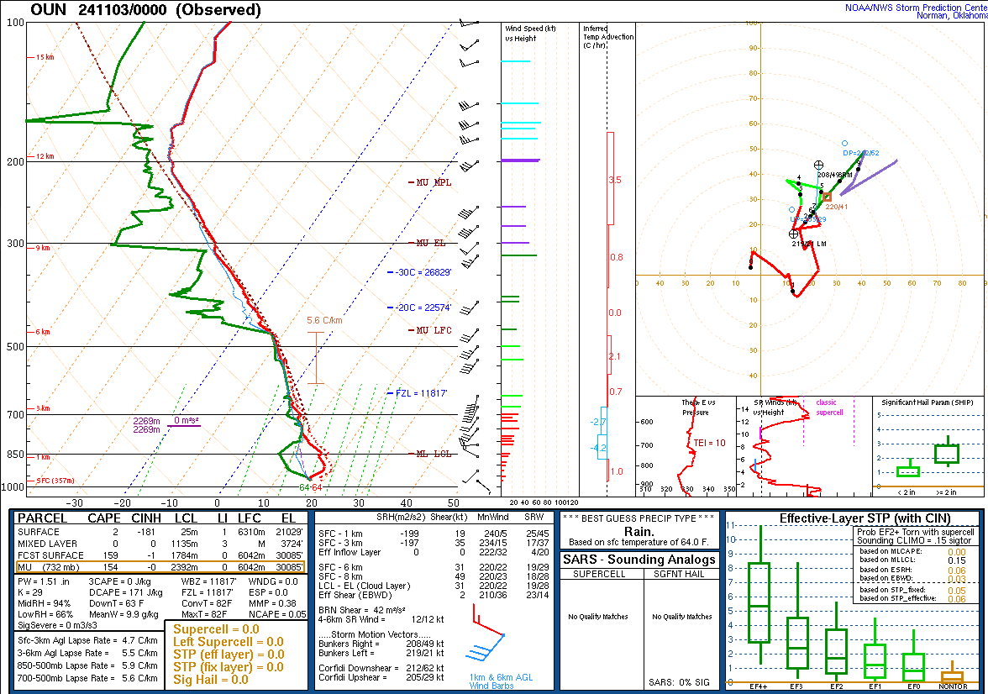
Confirmation Bias
Acknowledging signals that conform to your prior beliefs while ignoring or discounting signals that refute your prior beliefs.
Weather Example: November 2/3, 2024
2% Tornado risk going into the overnight hours
for central Oklahoma…
…The 00z OUN sounding shows a poor tornado environment…
Expectation for tornadoes should be low, right?

Slide 11
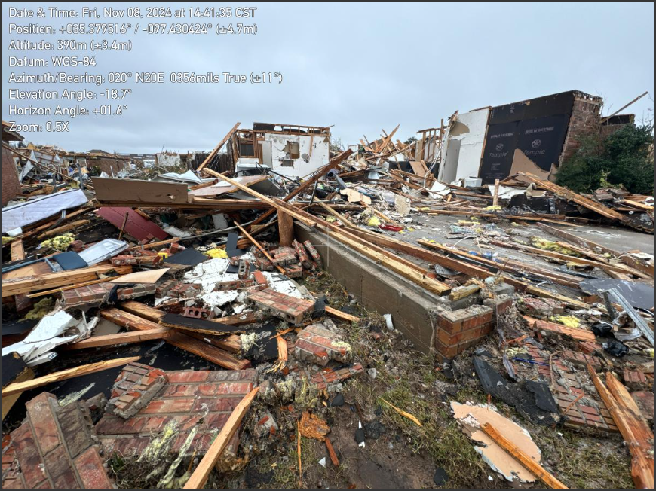
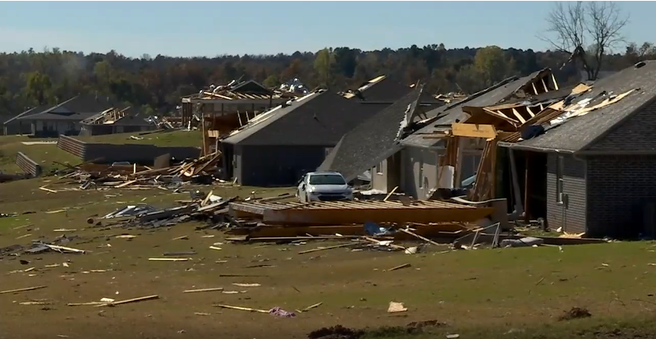
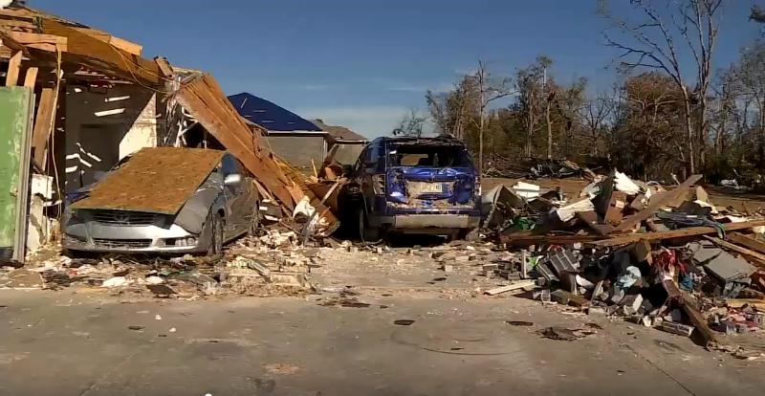
Confirmation Bias
Acknowledging signals that conform to your prior beliefs while ignoring or discounting signals that refute your prior beliefs.
Weather Example: November 2/3, 2024
2% Tornado risk going into the overnight hours
for central Oklahoma…
…The 00z OUN sounding shows a poor tornado environment…
Expectation for tornadoes should be low, right?
WRONG!

Slide 12
Confirmation Bias
Acknowledging signals that conform to your prior beliefs while ignoring or discounting signals that refute your prior beliefs.
Weather Example: November 2/3, 2024
2% Tornado risk going into the overnight hours
for central Oklahoma…
…The 00z OUN sounding shows a poor tornado environment…
Expectation for tornadoes should be low, right?
How to account for this?
Recognize situations when conditions can change rapidly.
Keep an open mind if data does not conform to your expectations. Don’t ignore it!

Slide 13
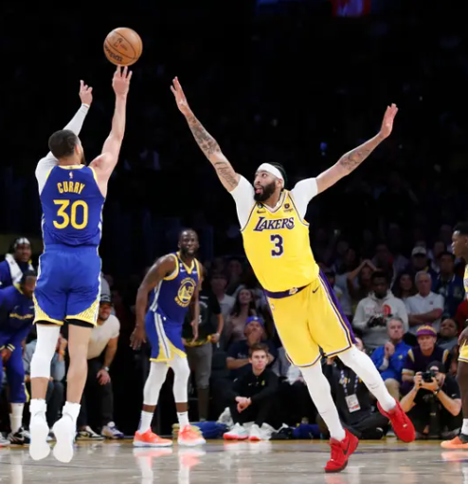

Recency Bias
The belief that events that have just happened in the recent past are likely to occur again the near future.
Example: A basketball star has a 60% shooting percentage. He has recently made 5 baskets in a row. What is the probability that he makes 6 in a row?

Slide 14
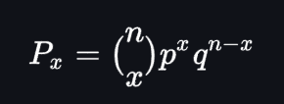
Recency Bias
The belief that events that have just happened in the recent past are likely to occur again the near future.
Example: A basketball star has a 60% shooting percentage. He has recently made 5 baskets in a row. What is the probability that he makes 6 in a row?
The answer: 5% chance!
How do we know? We use a binomial distribution from statistics!

Slide 15
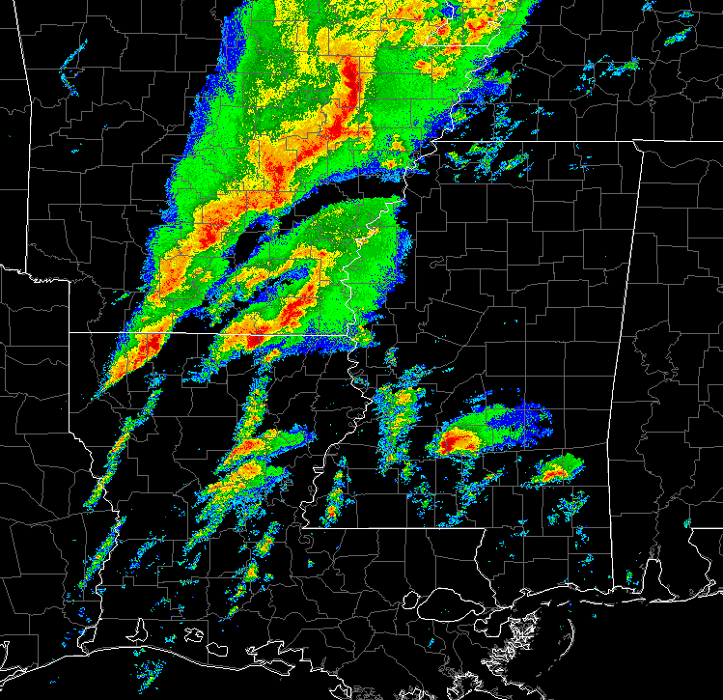
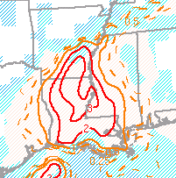
Recency Bias
The belief that events that have just happened in the recent past are likely to occur again the near future.
Weather Example: March 24, 2023
A high-end tornado environment has yielded zero tornadoes over the past 3-4 hours, and you’re heading into the evening hours.
Is it time to let your guard down?
STP

Slide 16
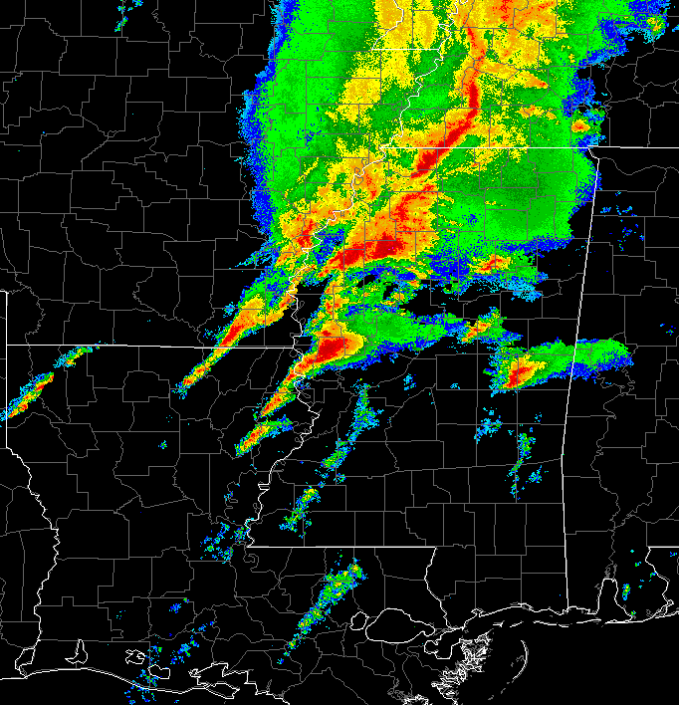
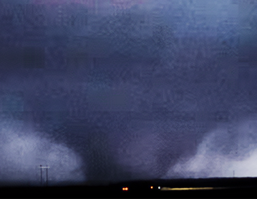
Recency Bias
The belief that events that have just happened in the recent past are likely to occur again the near future.
Weather Example: March 24, 2023
Just because an event has recently under-performed, doesn’t mean it won’t overperform momentarily!
(And vise versa.)
“Past results do not guarantee future performance”
STP

Slide 17
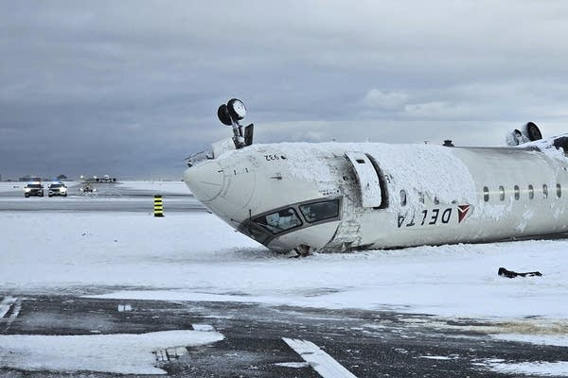
Availability Bias
When considering a range of possible outcomes, assuming that events that more easily come to mind are more likely to occur.
Example: There was recently a high-profile plane crash, so you decided to drive to your destination instead of flying.
The problem? You’re statistically more likely to die in a car crash than a plane crash!
The recent memory of the plane crash led you to choose a more risky mode of travel.

Slide 18
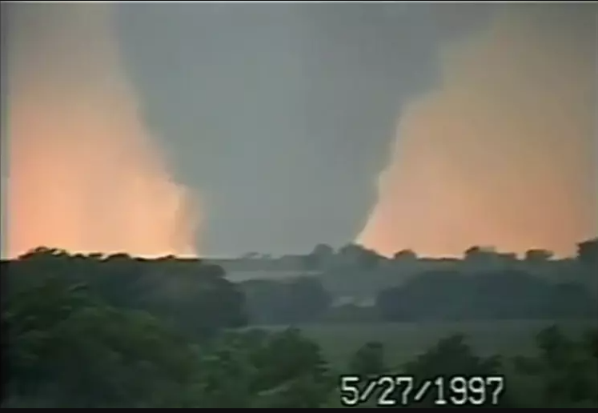
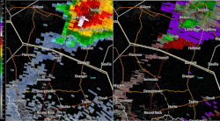
Availability Bias
When considering a range of possible outcomes, assuming that events that more easily come to mind are more likely to occur.
Weather Example: Jarell, TX F-5
Should we necessarily forecast a violent tornado every time there’s extreme buoyancy and a stalled boundary? It’s good to recognize analogs, but be aware of their limitations!
Extreme buoyancy +
Low SRH +
Stalled cold front =
F-5 Tornado?

Slide 19
Meet Linda…
Linda is 31 years old, single, outspoken, and very bright. She majored in philosophy. As a student, she was deeply concerned with issues of discrimination and social justice, and also participated in anti-nuclear demonstrations.
Which of the following is more probable?
Linda is a bank teller.
Linda is a bank teller, and is active in the feminists movement.

Slide 20
Meet Linda…
Linda is 31 years old, single, outspoken, and very bright. She majored in philosophy. As a student, she was deeply concerned with issues of discrimination and social justice, and also participated in anti-nuclear demonstrations.
Which of the following is more probable?
Linda is a bank teller.
Linda is a bank teller, and is active in the feminists movement.
Why? Consider the background probabilities!
How many bank tellers are there in the world?
How many people are active in the feminist movement?
How many people are both a bank teller and active in the feminist movement?
Probability theory tells us that answer A has a higher probability than answer B.

Slide 21
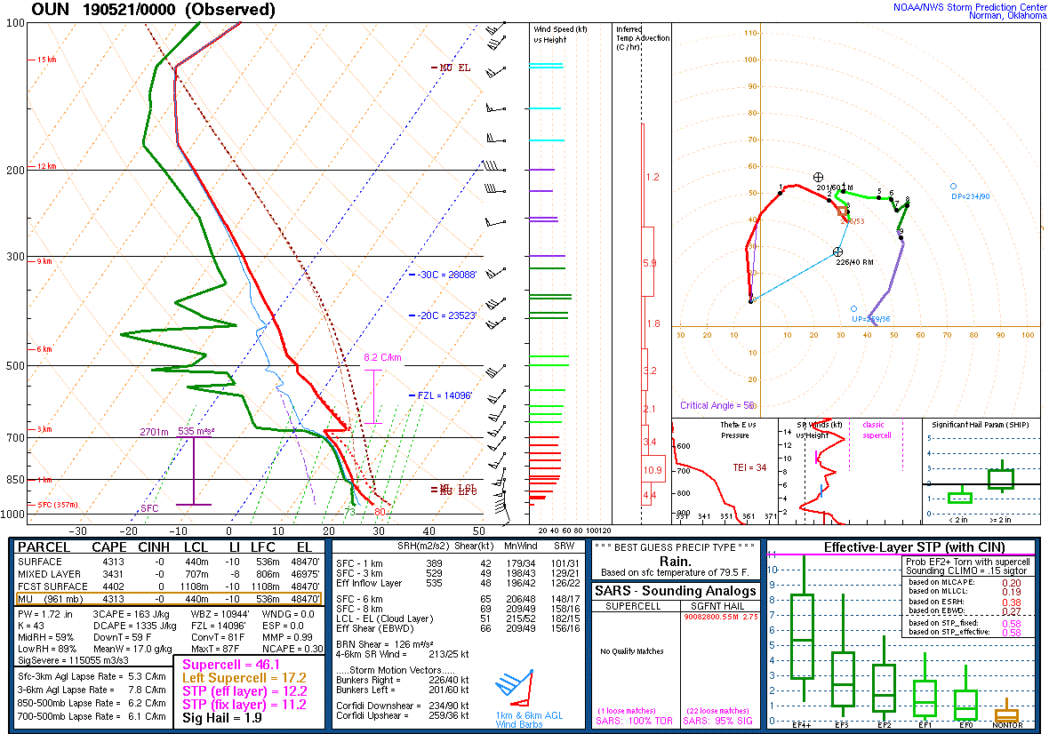
Conjunction Bias
Making an assessment of a scenario or outcome with incomplete data while ignoring background statistics.
Our brains have an inherent need to be able to explain/understand our world. So, we take incomplete data and fill in the gaps!
However, if we don’t utilize background statistics (i.e. probabilities) we can make erroneous judgements.
Wx example:
Explaining the 5/20/2019 forecast bust.
Was this really the reason this event wasn’t as prolific as expected? Do statistics actually support this or are we just letting our minds fill in the gaps?

Slide 22
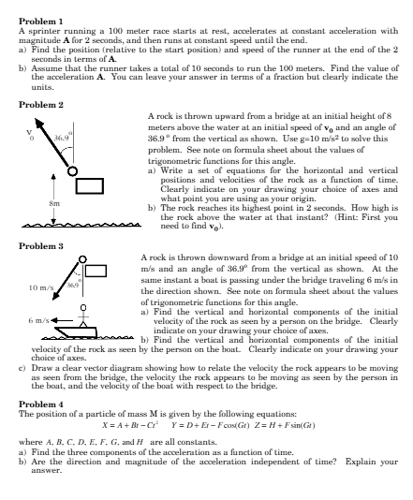

Stress Effect
When stress levels go up, our ability to think slowly and critically goes down.
We tend to revert back to our baseline impulses and biases as a means of eliminating acute stress.
This leads to suboptimal decision making!
Example: Taking a test!

Slide 23
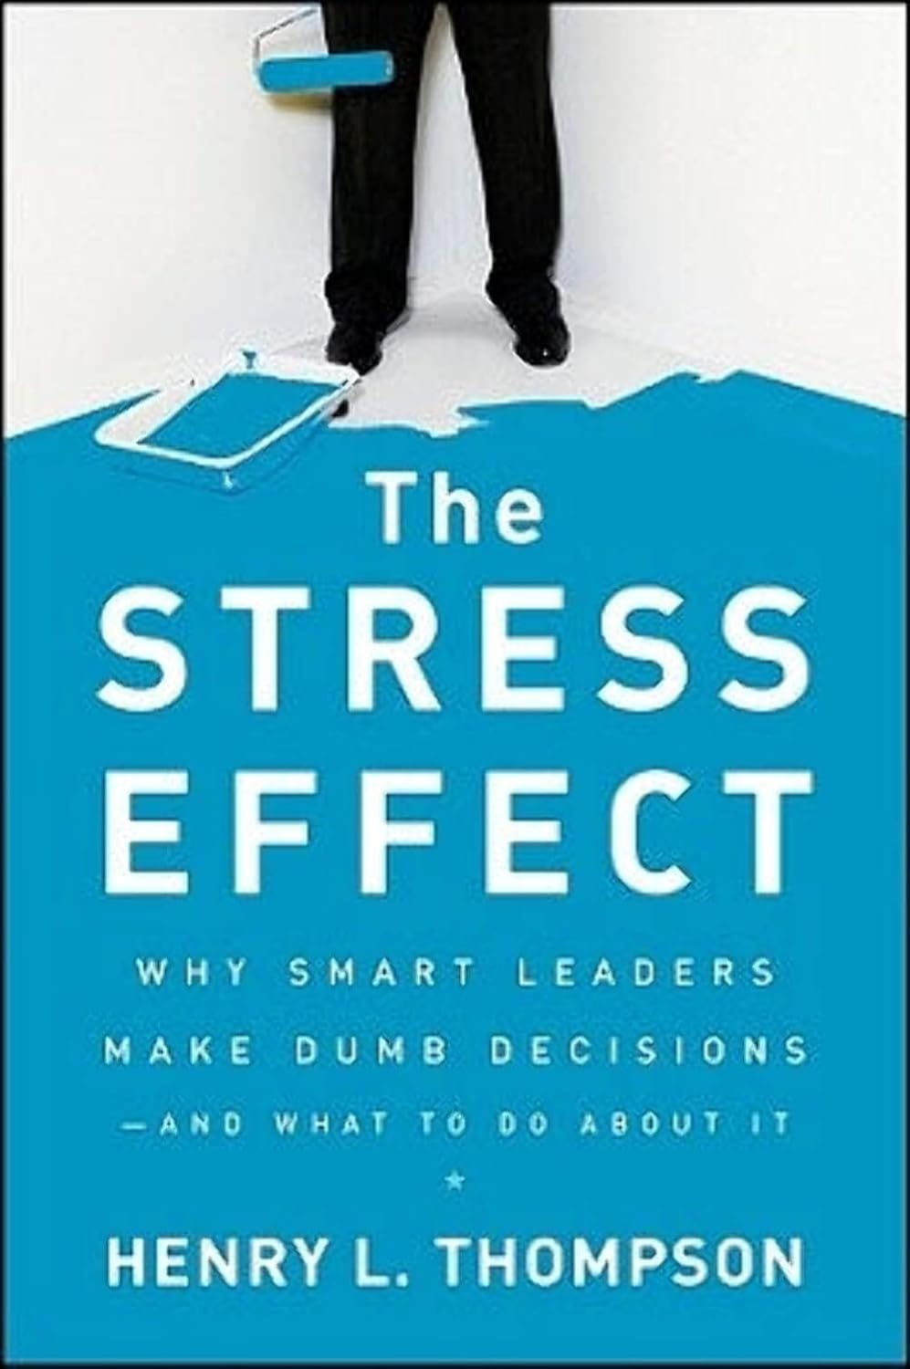
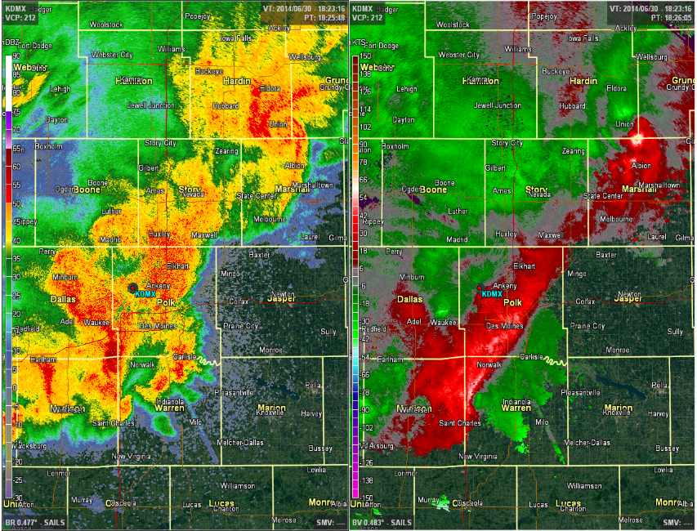
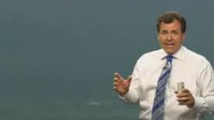
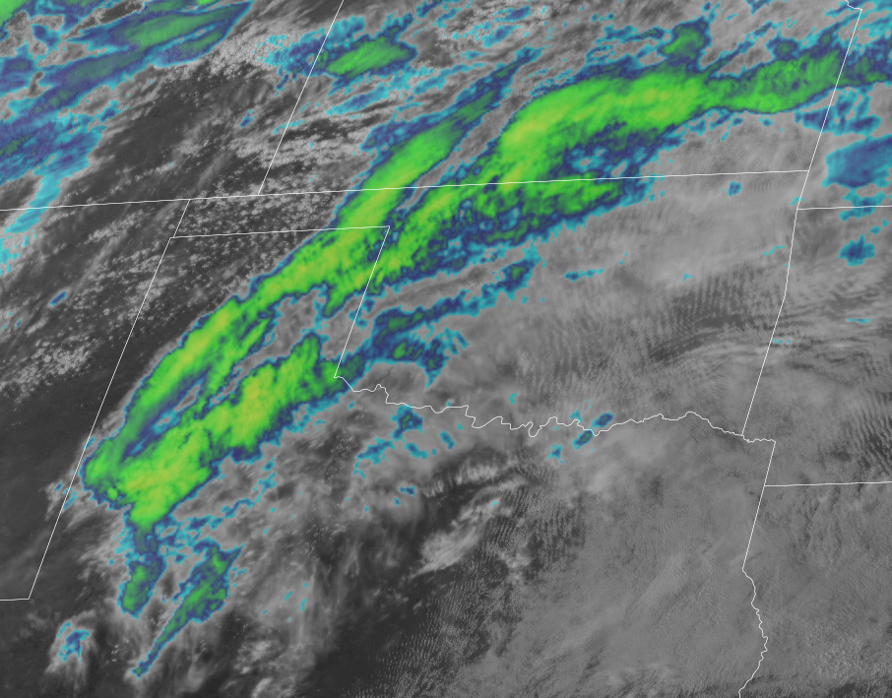
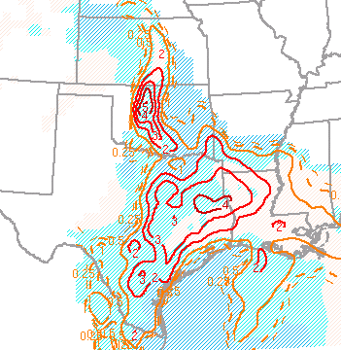
Stress Effect
When stress levels go up, our ability to think slowly and critically goes down.
We tend to revert back to our baseline impulses and biases as a means of eliminating acute stress.
This leads to suboptimal decision making!
Example: Warning decisions!
How do you make better warning decisions? Practice under stress!

Slide 24
Question!
You have the option to play a game:
A coin is flipped. If it’s heads, you gain $40. If it’s tails, you lose $20.
Do you play the game?

Slide 25
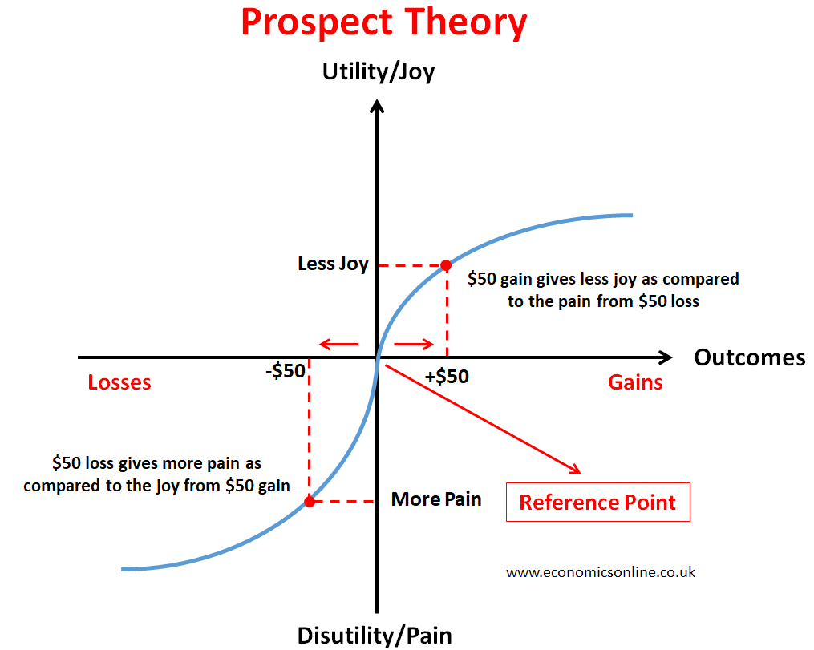
Loss Aversion
The sensation of loss that we experience is often greater than the sensation of gain for an equivalent value depending on an initial reference point.
This is part of Prospect Theory.
Example:
Losing $50 feels worse when you have
$100 in the bank vs. $1,000 in the bank.

Slide 26
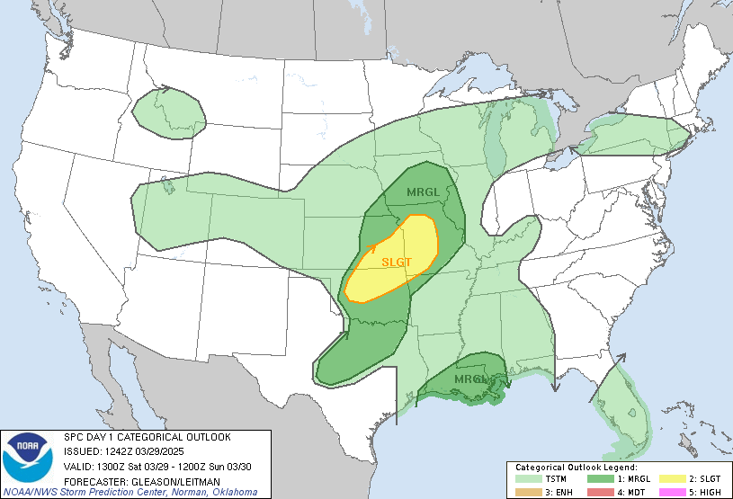
Loss Aversion
The sensation of loss that we experience is often greater than the sensation of gain for an equivalent value depending on an initial reference point.
Here’s the forecast you inherited.
New data does not look as good as it did before.
Do you downgrade?

Slide 27
Beware of “lollapalooza effects”!
Many biases can be at play at the same time and compound on each other, leading to unexpected outcomes (i.e. very bad decisions!)
Unexpected Tornado
Similar pattern emerges,
Start messaging tornadoes
New data doesn’t look as good,
But maintain messaging anyway
Over forecast!
(Induces background stress)
“This wasn’t May 3rd
all over again.”
(availability & recency bias)
(anchoring, confirmation bias, & loss aversion)

Slide 28
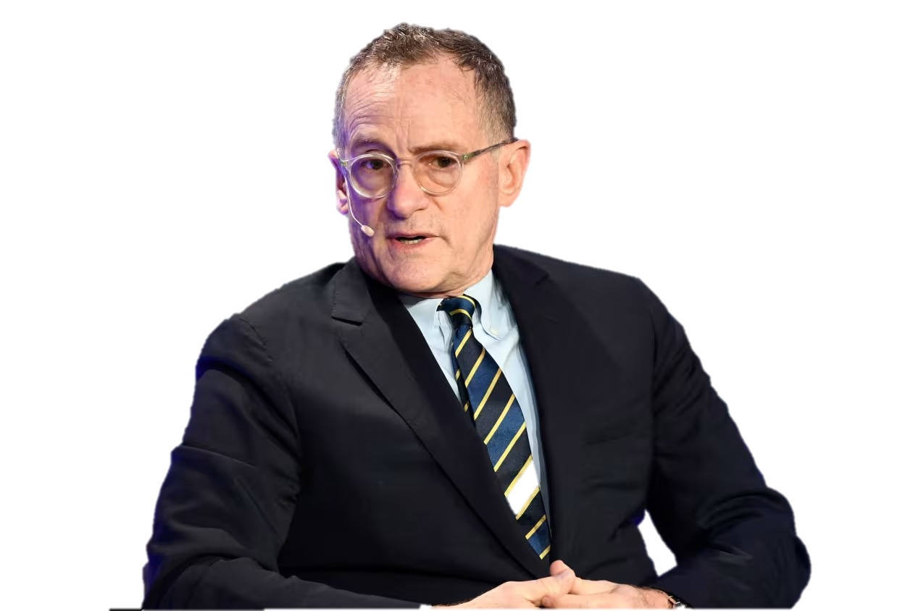
The
“What You See Is All There Is”
Assumption
When making decisions, we place too much emphasis on the “Known Knowns” (i.e. what we know and are familiar with)
We place too little emphasis on the “Known Unknowns” (i.e. things we’re aware of but not comfortable with or have poor data/understanding).
We place no emphasis on the “Unknown Unknowns” (i.e. things about which we aren’t aware and haven’t measured).
“There are forecasters who know they don’t know, and forecasters who don’t know they don’t know.”
- Howard Marks
(really good investor)

Slide 29
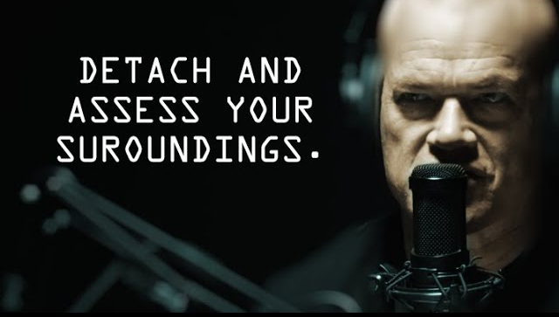
How to avoid these biases
Practice under stress
Think in terms of probabilities
  Be aware of the range of potential outcomes, and recognize when the range of potential outcomes is unknown!
Look at CAMs, ML guidance, and other people’s forecasts very last
Work on detachment
  Look up
  Take a deep breath
  Assess the big picture
Honest self-assessment

Slide 30
Go Forth & Make Better Decisions!
Recommended reading:
Thinking Fast and Slow
- Daniel Kahneman
Noise
- Daniel Kahneman, Olivier Sibony, Cass Sunstein
Poor Charlie’s Almanac
- Charlie Munger
The Stress Effect
- Henry Thompson

